Slide 1
Big Brother
1. Milestone

Slide 2
DataBase
Ressources
GridFS
MongoDB
Database structure
1. Milestone

Slide 3
Database – Ressources
Getting Started:
Introduction into how it works: https://www.mongodb.com/docs/manual/tutorial/getting-started/
Setting atlas up: https://www.mongodb.com/docs/atlas/getting-started/
With Python (and pymongo):
Introductory: https://www.youtube.com/watch?v=rE_bJl2GAY8
Reading more about it:
Very short tutorial: https://www.mongodb.com/docs/drivers/pymongo/
https://pymongo.readthedocs.io/en/stable/ -> https://pymongo.readthedocs.io/en/stable/tutorial.html
Design:
https://www.youtube.com/watch?v=leNCfU5SYR8
Schema Design Patterns: https://www.mongodb.com/blog/post/building-with-patterns-a-summary
How not to design - Anti-patterns: https://www.youtube.com/watch?v=8CZs-0it9r4&list=PL4RCxklHWZ9uluV0YBxeuwpEa0FWdmCRy

Slide 4


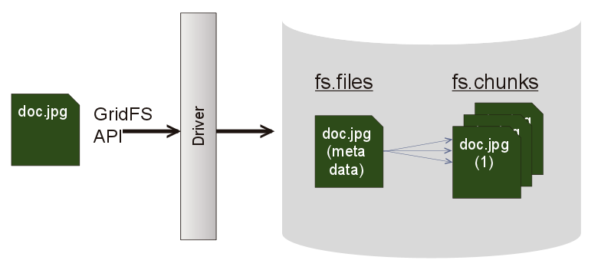
GridFs
MongoDB doesn’t allow you to store files that are larger than 16MB
In order to store them you would need GridFs
Breaking up files into
fs.files: Contains data about those files
fs.chunks: Contains data about chunks
Makes loading videos easier
Abb. 1: gridfs1.png (797×365)

Slide 5
Gridfs – ressources
Overview: https://www.youtube.com/watch?v=GDUbWNJLPnc
Documentation: https://www.mongodb.com/docs/manual/core/gridfs/
With pymongo:
Introduction: https://pymongo.readthedocs.io/en/stable/examples/gridfs.html
Read more: https://pymongo.readthedocs.io/en/stable/api/gridfs/index.html#module-gridfs

Slide 6
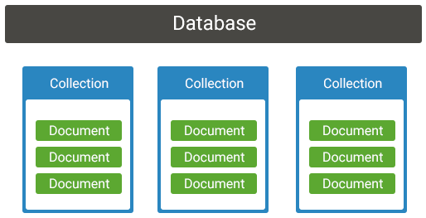
Mongodb
Not classical relational model
Adaptable to queries
More flexible
More manageable
Abb. 2: https://www.koderhq.com/img/mongodb/collections.png

Slide 7
Database – Big Brother
User***
Login_attempt***
Ressource_context**
Ressource**
_id: UUID*
username: String
user_enc: String
is_admin: Bool
_id: UUID*
user_id: UUID*
date: Date
login_suc: String
success_res: String
_id: UUID*
username: String
res_id: [UUID*]
_id: UUID*
user_id: UUID*
date: Date
res_cxt_id: [UUID*]
* UUIDs are being stored as Strings
** Ressource and Ressource_context: used for training data
*** User and Login_attempt is used for user logins

Slide 8
1. Milestone
Done:
Created scheme for database
Converted Database into MongoDB
Setup and write documentation for Database management API
Next milestone:
Discussing small scheme changes to load documents more efficient
Finish implementing scheme
Implementing further queries
Help frontend with fixing issues connected to the database
Create user-groups on DB-side to rights

Slide 9
Logik
Python Module (until now)
1. Milestone
TODO

Slide 10
Python Module (until now)
OpenCV (mainly)
numpy (math)
mediapipie & tensorflow (still some problems we need to deal with ) (machine learning)

Slide 11

1. Milestone
Video resource
Live face recognition
Palm detection
Gesture detection and other functions related with finger movement

Slide 12
TOdo
more useful functions/improvement of current algorithms
determine and achieve the highest possible efficiency of the algorithms (for example, excluding the possibility to abuse the face recognition)
Enabling the program to work better in poor lighting conditions (providing user with information on better camera positioning)
Cooperation (parallel) “Live face recognition”- and “Gesture detection” - programs

Slide 13
Frontend
Removed obsolete or unused requirements
Python versions customized
Pip installations all performed
Code was intensively considered and analyzed
→ Make Code less redundant and clear

Slide 14

Frontend – New Milestone
Make Code less redundant and clear
resolve interface issues
completeness and functionality of the website

